Slide 1
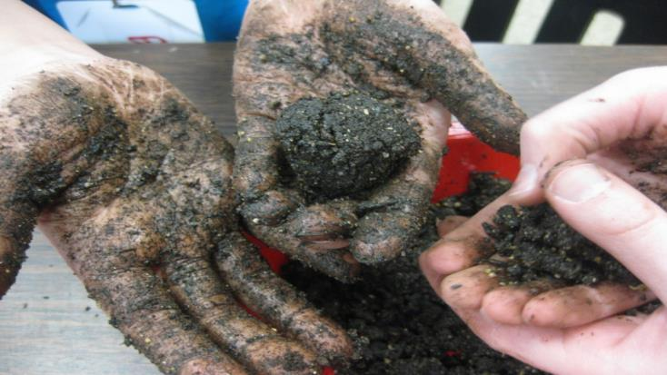
Let’s Get Started!
How to make a Seed Bomb

Slide 2
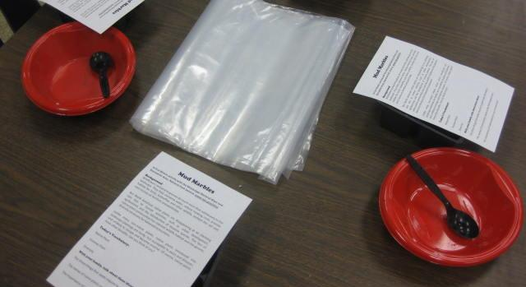
STEP ONE:
Put
3 big spoonfuls of sand &
3 big spoonfuls of compost in your bowl

Slide 3
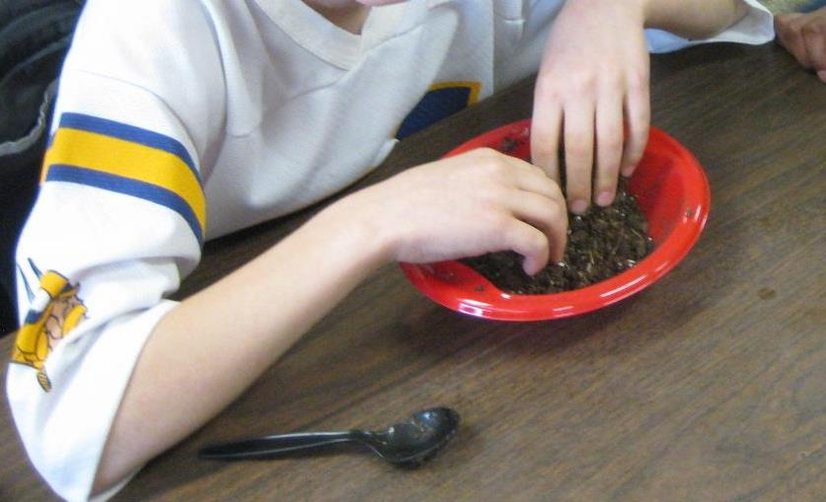
STEP TWO:
Add 1 cup of soil to bowl.
Stir and break up large clumps.

Slide 4
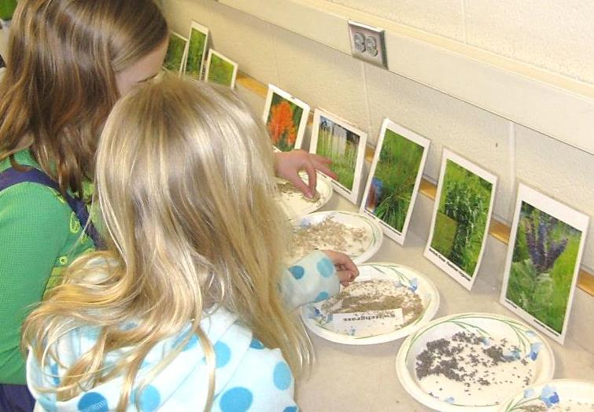
STEP THREE:
Add three “pinches” of seeds
Notes:
The seeds can be three of the same or a mixture of different types

Slide 5
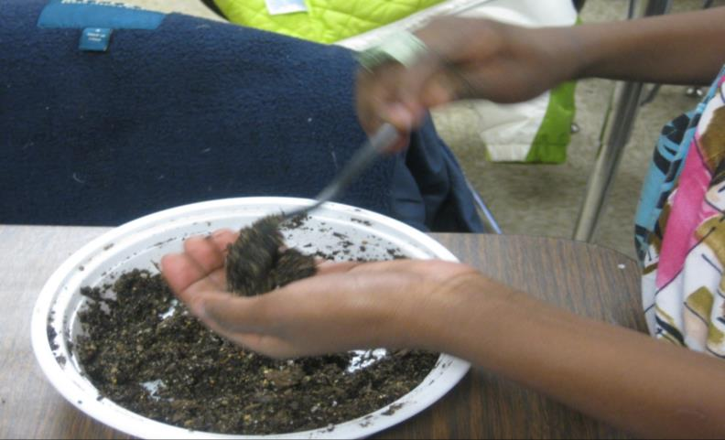
STEP FOUR:
Add 4 spoonfuls of water to make soil moist. Stir.
Notes:
Don’t add more than 4 spoonfuls until the students have stirred and worked with the mixture trying to form balls. Only then, can another spoonful be added.

Slide 6
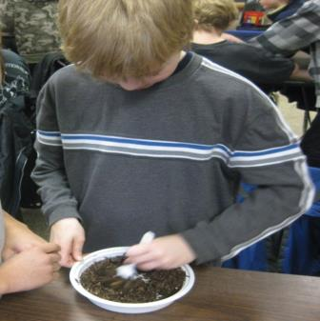
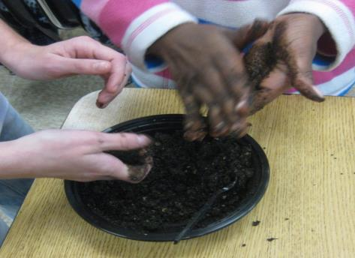
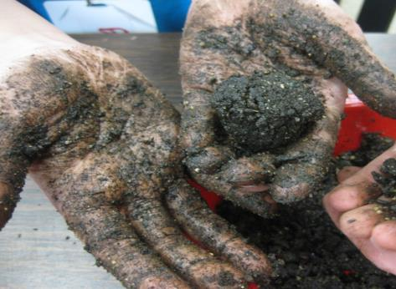
STEP FIVE:
Take a golf ball sized amount of the mixture.
Squeeze 15 times until the mixture sticks together to form a ball.
Notes:
The students really need to squeez 15 times. Try for a golf ball or ping pong ball sized ball. Any smaller and there’s not enough soil. Any larger and it won’t break down correctly.

Slide 7
STEP 6:
Let the seed balls dry.
If you take them home in a plastic bag:
-open the bag to let them dry
-only throw seed bombs where your parents say it’s okay
Notes:
The seed balls ideally should fall on bare ground although because there is soil and compost in the ball, the seeds have all they need to begin growing. Talk to the group about appropriate places to put the balls they bring home.

Slide 8
Have Fun!
3 spoonfuls of sand
3 spoonfuls of compost
1 cup of soil
3 pinches of seeds
4 spoonfuls of water

